Slide 1
Linear Function in Coordinate System
Hung-yi Lee

Slide 2
Outline
Describing a function in a coordinate system
A complex function in one coordinate system can be simple in other systems.
Reference: Textbook Chapter 4.5
Notes:
Why we have to do that?

Slide 3
Basic Idea
Simple Function
Another coordinate system
output’
Input’
Cartesian coordinate system
Input
Output
Complex Function
Notes:
Why we have to do that?

Slide 4
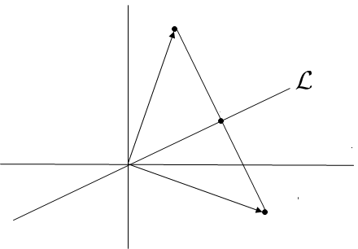





Sometimes a function can be complex ……
Example: reflection about a line L through the origin in R²
$$\left[\begin{aligned}x_{1} \\ x_{2}\end{aligned}\right]$$
$$T\left(\left[\begin{aligned}x_{1} \\ x_{2}\end{aligned}\right]\right)=?$$
$$\left[T\right]=\left[\begin{matrix}T\left(e_{1}\right) & T\left(e_{2}\right) \end{matrix}\right]$$
$$=?$$
$$T\left(\left[\begin{aligned}x_{1} \\ x_{2}\end{aligned}\right]\right)$$

Slide 5


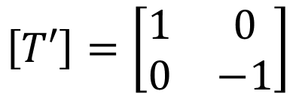






Sometimes a function can be complex ……
Example: reflection about a line L through the origin in R²
special case: L is the horizontal axis
$$T′\left(\left[\begin{aligned}x_{1} \\ x_{2}\end{aligned}\right]\right)=?$$
$$\left[\begin{aligned}x_{1} \\ {−x}_{2}\end{aligned}\right]$$
$$\left[\begin{aligned}x_{1} \\ x_{2}\end{aligned}\right]$$
$$\left[T′\right]=\left[\begin{matrix}1 & 0 \\ 0 & −1\end{matrix}\right]$$
$$T′\left(\left[\begin{aligned}x_{1} \\ x_{2}\end{aligned}\right]\right)$$
$$T′\left(e_{1}\right)$$
$$T′\left(e_{2}\right)$$
$$=e_{1}$$
$$=−e_{2}$$
Notes:
A similar but simpler function

Slide 6





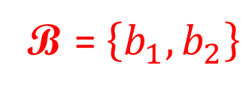
Describing the function in another coordinate system
Example: reflection about a line L through the origin in R²
In another coordinate system B ….
B = $\left\{b_{1},b_{2}\right\}$
$$T\left(b_{2}\right)=−b_{2}$$
$$b_{2}$$
$$b_{1}$$
$$T\left(b_{1}\right)=b_{1}$$

Slide 7












Describing the function in another coordinate system
Example: reflection about a line L through the origin in R²
$${\left[T\right]}_{\text{B}}$$
$$=\left[\begin{matrix}1 & 0 \\ 0 & −1\end{matrix}\right]$$
In another coordinate system B ….
Input and output are both in B
$${\left[b_{2}\right]}_{\text{B}}=$$
$$e_{2}$$
$$\left[T\right]b_{1}=b_{1}$$
$${\left[T\right]}_{\text{B}}\left({\left[b_{1}\right]}_{\text{B}}\right)={\left[b_{1}\right]}_{\text{B}}$$
$${\left[T\right]}_{\text{B}}\left(e_{1}\right)=e_{1}$$
$${\left[b_{1}\right]}_{\text{B}}=$$
$$\left[T\right]b_{2}=−b_{2}$$
$$e_{1}$$
$${\left[T\right]}_{\text{B}}\left({\left[b_{2}\right]}_{\text{B}}\right)={\left[−b_{2}\right]}_{\text{B}}$$
$${\left[T\right]}_{\text{B}}\left(e_{2}\right)=−e_{2}$$
Notes:
T 下標 B 上標 gamma

Slide 8

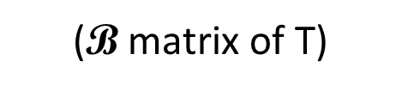






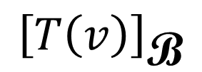

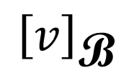

Flowchart
$${\left[T\right]}_{\text{B}}$$
$$=\left[\begin{matrix}1 & 0 \\ 0 & −1\end{matrix}\right]$$
($\text{B}$ matrix of T)
$${\left[v\right]}_{\text{B}}$$
$${\left[T\left(v\right)\right]}_{\text{B}}$$
$$b_{1}$$
$$b_{2}$$
reflection about the horizontal line
$$e_{2}$$
$$\left[T\right]=?$$
$$v$$
$$T\left(v\right)$$
$$e_{1}$$
reflection about a line L

Slide 9











Flowchart
$${\left[T\right]}_{\text{B}}$$
$${\left[v\right]}_{\text{B}}$$
$${\left[T\left(v\right)\right]}_{\text{B}}$$
$\text{B}$coordinate system
$$B$$
Cartesian coordinate system
$$B^{−1}$$
$$\left[T\right]=?$$
$$v$$
$$T\left(v\right)$$
$$A=B{\left[T\right]}_{\text{B}}B^{−1}$$
$${\left[T\right]}_{\text{B}}=B^{−1}AB$$
similar
similar

Slide 10

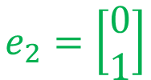


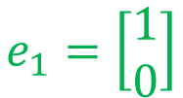
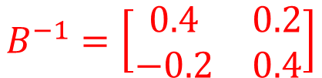

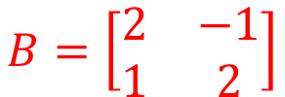

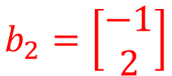


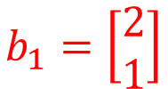


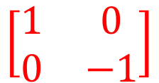
Example: reflection operator T about the line y = (1/2)x
$$B^{−1}=\left[\begin{matrix}0.4 & 0.2 \\ −0.2 & 0.4\end{matrix}\right]$$
$$B=\left[\begin{matrix}2 & −1 \\ 1 & 2\end{matrix}\right]$$
$$b_{2}=\left[\begin{aligned}−1 \\ 2\end{aligned}\right]$$
y = (1/2)x
$${\left[T\right]}_{\text{B}}$$
$${\left[v\right]}_{\text{B}}$$
$${\left[T\left(v\right)\right]}_{\text{B}}$$
$$b_{1}=\left[\begin{aligned}2 \\ 1\end{aligned}\right]$$
$$\left[\begin{matrix}1 & 0 \\ 0 & −1\end{matrix}\right]$$
$$B^{−1}$$
$$B$$
y = (1/2)x
$$e_{2}=\left[\begin{aligned}0 \\ 1\end{aligned}\right]$$
$$A=?$$
$$v$$
$$T\left(v\right)$$
$$e_{1}=\left[\begin{aligned}1 \\ 0\end{aligned}\right]$$
$$A=B{\left[T\right]}_{\text{B}}B^{−1}$$

Slide 11

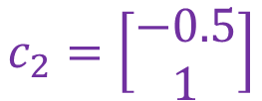
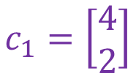
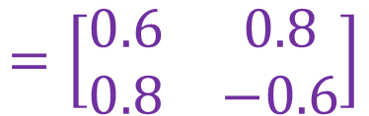

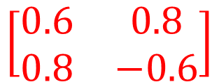
Example: reflection operator T about the line y = (1/2)x
$$B^{−1}=\left[\begin{matrix}0.4 & 0.2 \\ −0.2 & 0.4\end{matrix}\right]$$
$$B=\left[\begin{matrix}2 & −1 \\ 1 & 2\end{matrix}\right]$$
$$A=$$
$$\left[\begin{matrix}0.6 & 0.8 \\ 0.8 & −0.6\end{matrix}\right]$$
$${\left[T\right]}_{\text{B}}$$
$${\left[v\right]}_{\text{B}}$$
$${\left[T\left(v\right)\right]}_{\text{B}}$$
$$c_{2}=\left[\begin{aligned}−0.5 \\ 1\end{aligned}\right]$$
y = (1/2)x
$$\left[\begin{matrix}1 & 0 \\ 0 & −1\end{matrix}\right]$$
$$c_{1}=\left[\begin{aligned}4 \\ 2\end{aligned}\right]$$
$$B^{−1}$$
$$B$$
$$A=?$$
$$A=C{\left[T\right]}_{\text{C}}C^{−1}$$
$$v$$
$$T\left(v\right)$$
$$=\left[\begin{matrix}0.6 & 0.8 \\ 0.8 & −0.6\end{matrix}\right]$$
$$A=B{\left[T\right]}_{\text{B}}B^{−1}$$
Notes:
0.6000 0.8000
0.8000 -0.6000

Slide 12


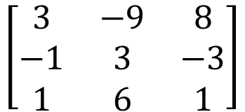


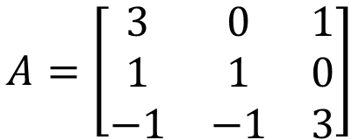








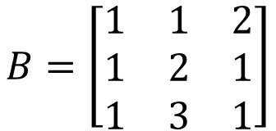
Example 2 (P279)
$${\left[T\right]}_{\text{B}}=?$$
$$A=\left[\begin{matrix}3 & 0 & 1 \\ 1 & 1 & 0 \\ −1 & −1 & 3\end{matrix}\right]$$
$${\left[v\right]}_{\text{B}}$$
$${\left[T\left(v\right)\right]}_{\text{B}}$$
$${ \left[T\right]}_{\text{B}}=B^{−1}AB$$
$$B=\left[\begin{matrix}1 & 1 & 2 \\ 1 & 2 & 1 \\ 1 & 3 & 1\end{matrix}\right]$$
$$B^{−1}$$
$$B$$
$$\left[\begin{matrix}3 & −9 & 8 \\ −1 & 3 & −3 \\ 1 & 6 & 1\end{matrix}\right]$$
$A$ is known
$$v$$
$$T\left(v\right)$$
$${ \left[T\right]}_{\text{B}}=$$
$$A=B{ \left[T\right]}_{\text{B}}B^{−1}$$
Notes:
3 -9 8
-1 3 -3
1 6 1

Slide 13








Example 3 (P279)
Determine T
b₁
c₁
b₂
c₂
b₃
c₃
e₁
e₂
e₃
$${\left[v\right]}_{\text{B}}$$
$${\left[T\left(v\right)\right]}_{\text{B}}$$
B⁻¹c₁
B⁻¹c₂
B⁻¹c₃
$${\left[T\right]}_{\text{B}}$$
b₁, b₂, b₃ as a coordinate system
$$B^{−1}$$
$$B^{−1}$$
{b₁, b₂, b₃} is a basis of R³
$$A$$
b₁
b₂
b₃
$$v$$
$$T\left(v\right)$$
c₁
c₂
c₃
Notes:
Simple …..
A = C B ^ -1

Slide 14






Example 3 (P279)
Determine T
$${\left[T\right]}_{\text{B}}=\left[\begin{matrix}B^{−1}c_{1} & B^{−1}c_{2} & B^{−1}c_{3}\end{matrix}\right]$$
$$=B^{−1}C$$
$$A=B{\left[T\right]}_{\text{B}}B^{−1}$$
$$={BB}^{−1}CB^{−1}$$
$$=CB^{−1}$$
e₁
e₂
e₃
$${\left[v\right]}_{\text{B}}$$
$${\left[T\left(v\right)\right]}_{\text{B}}$$
B⁻¹c₁
B⁻¹c₂
B⁻¹c₃
$${\left[T\right]}_{\text{B}}$$
b₁, b₂, b₃ as a coordinate system
$$B^{−1}$$
$$B^{−1}$$
$$B$$
{b₁, b₂, b₃} is a basis of R³
$$A$$
b₁
b₂
b₃
$$v$$
$$T\left(v\right)$$
c₁
c₂
c₃

Slide 15



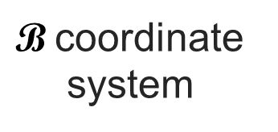







Inception
小開的父親說：
"I'm disappointed that you're trying so hard to be me."
小開有了不要繼承父業的念頭
$${\left[T\right]}_{\text{B}}$$
$\text{B}$coordinate system
$${\left[v\right]}_{\text{B}}$$
$${\left[T\left(v\right)\right]}_{\text{B}}$$
$${ \left[T\right]}_{\text{B}}=B^{−1}AB$$
夢境
$$B$$
清醒
Cartesian coordinate system
做夢
$$B^{−1}$$
$$\left[T\right]$$
$$v$$
$$T\left(v\right)$$
現實
$$\left[T\right]=B{ \left[T\right]}_{\text{B}}B^{−1}$$
小開解散公司
說服小開解散公司

